Slide 1
British Airways Task 2
Tsun Li Nicholas Tam

Slide 2
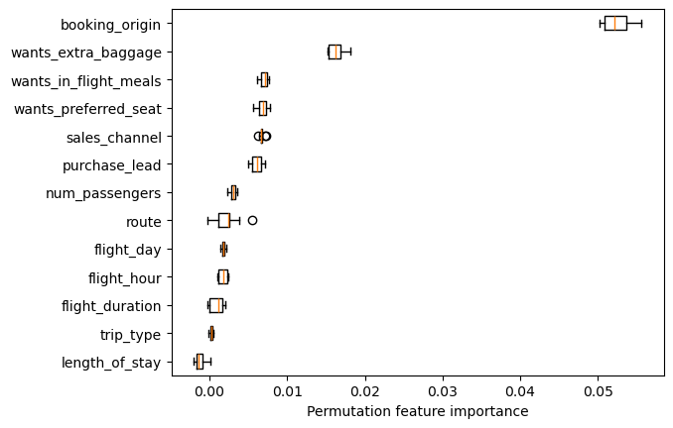
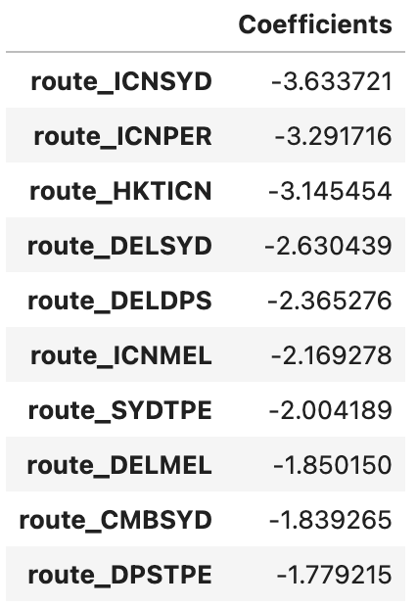
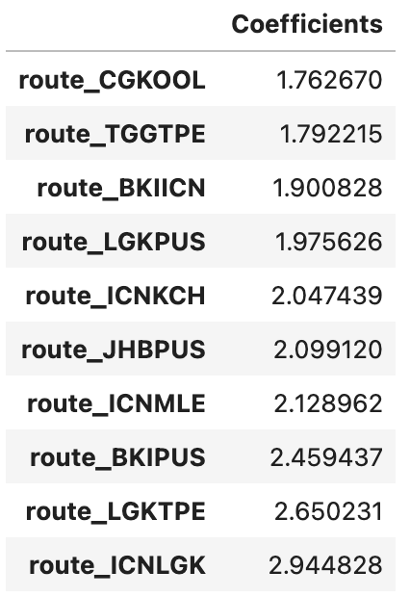
Optimised tree-based ensemble model results
Tree-based ensemble model
Tree-based ensemble model can only provide permutation importance in place of feature importances
Booking_origin has greatest feature importance, followed by the various customer wants, with emphasis on extra baggage
Logistic regression model
Various routes appear to provide consistently most extreme coefficients for predicting person’s customer buying behaviour
Questionable given that majority of variables created from transformations are from “route” feature

Slide 3
Optimised logistic regression model results
Various routes appear to provide consistently most extreme coefficients for predicting person’s customer buying behaviour
Questionable given that majority of variables created from transformations are from “route” feature

